Slide 1

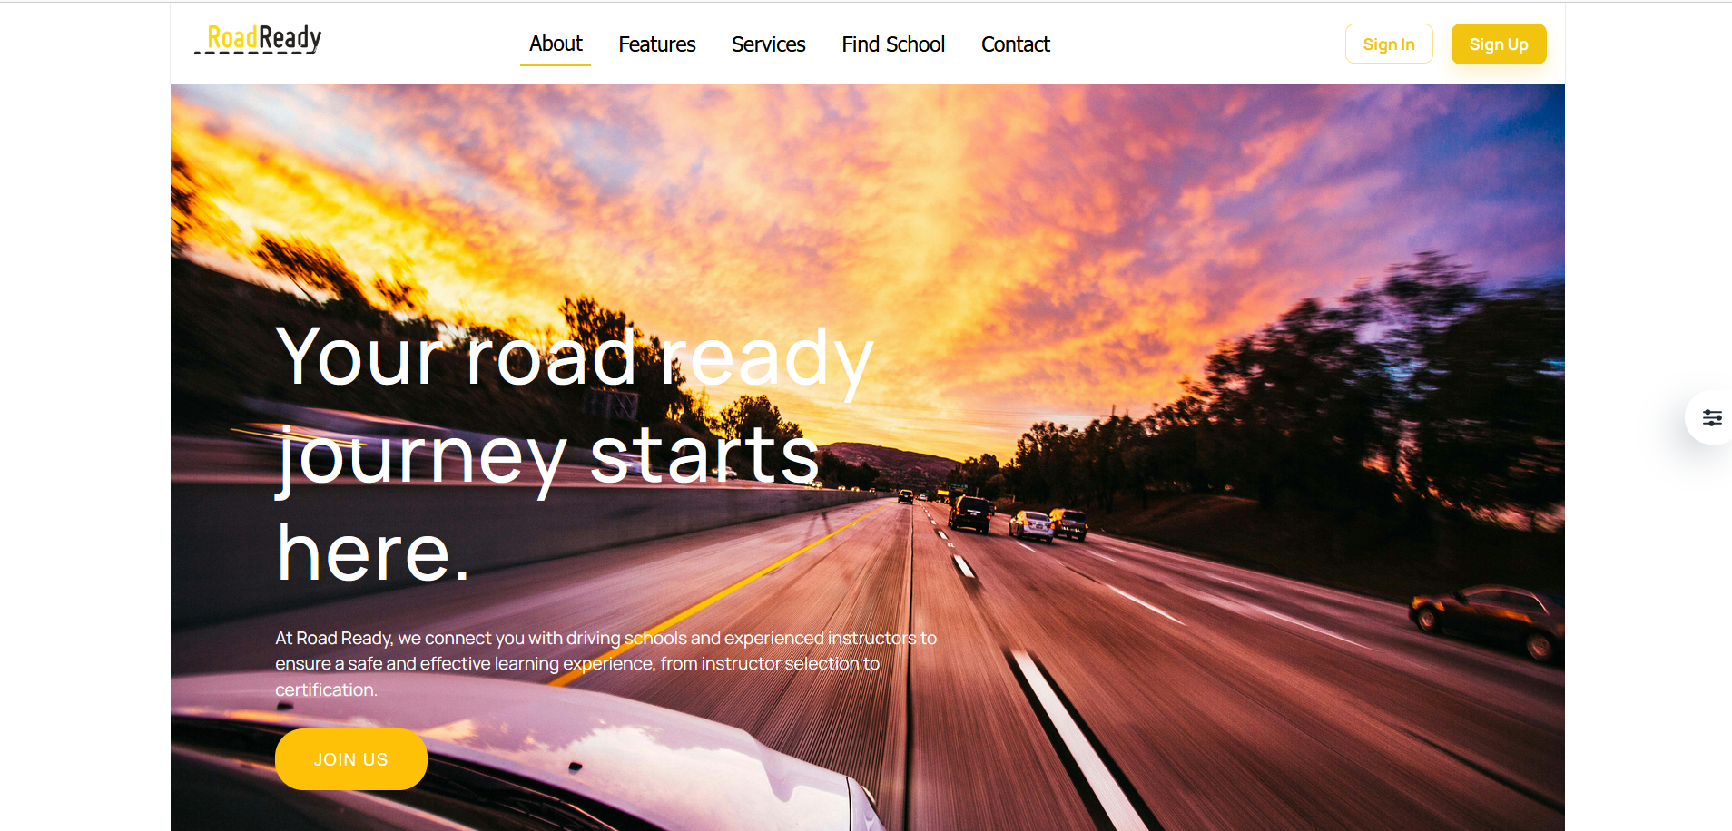
RoadReady
Your web platform connects learners with driving instructors and provides tools for practicing theory tests and tracking progress.

Slide 2
Outline
The Problem
Key Features
Technology
Demo
Future Plans

Slide 3
Why Road Ready?
🧭 No Centralized Platform
Students, instructors, and admins work across disconnected tools or processes.
Lack of communication between all parties involved in driver education.
📘 Limited Practice for Theory Exams
Learners often rely on outdated or informal sources to study driving theory.
No structured way to take mock exams or monitor progress.
🚗 Lack of Access to Qualified Instructors
Many learners struggle to find certified and experienced driving instructors.
There's no easy way to compare instructors based on ratings or location.

Slide 4
How Road Ready solves this problem
✅ Easy Instructor Finding
🧠 Theory Exam Practice
📊 Progress Tracking

Slide 5
Key Features
🔐 Secure, Role-Based Platform
Personalized dashboards for each user type (Student, Instructor, Admin).
🔍 Instructor Search
Students can filter instructors by location and rating.
📝 Theory Test Practice
Access to a library of practice questions based on real driving exams.
Feedback and score tracking to measure improvement.

Slide 6
Who uses Road Ready?
Student drivers
Certified instructors
Admins(driving school owners)

Slide 7
Utilized Technologies
🌐 Frontend
React JS
⚙️Backend
Java
☁️ Database
Firebase
Frontend (React.js)
User experience
HTML, CSS,JS

Slide 8

Site Demo

Slide 9
Now vs. Future Plans

Slide 10
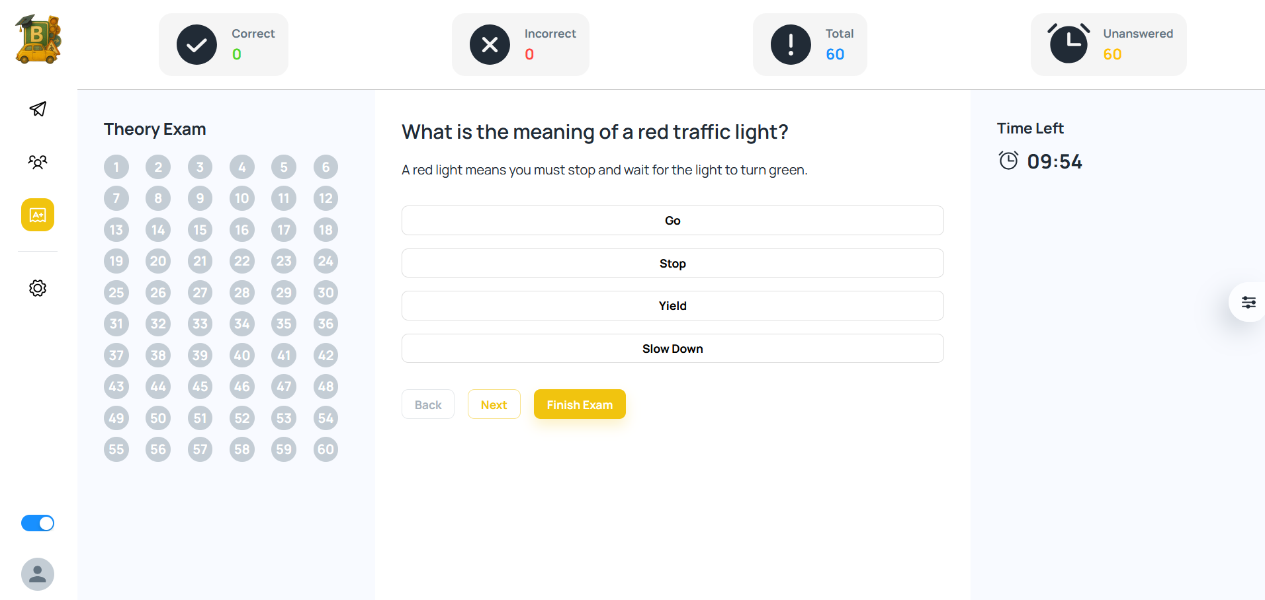

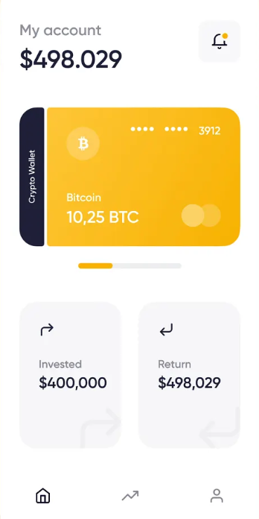
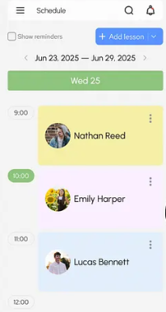
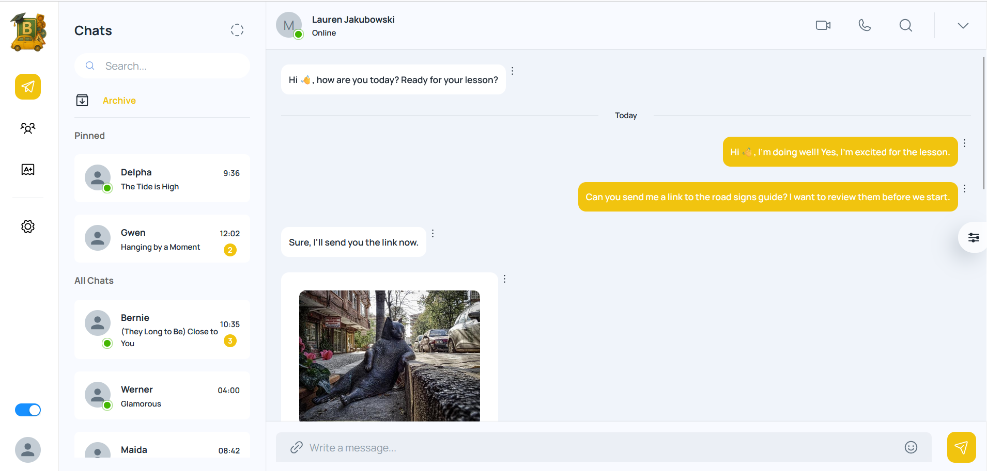
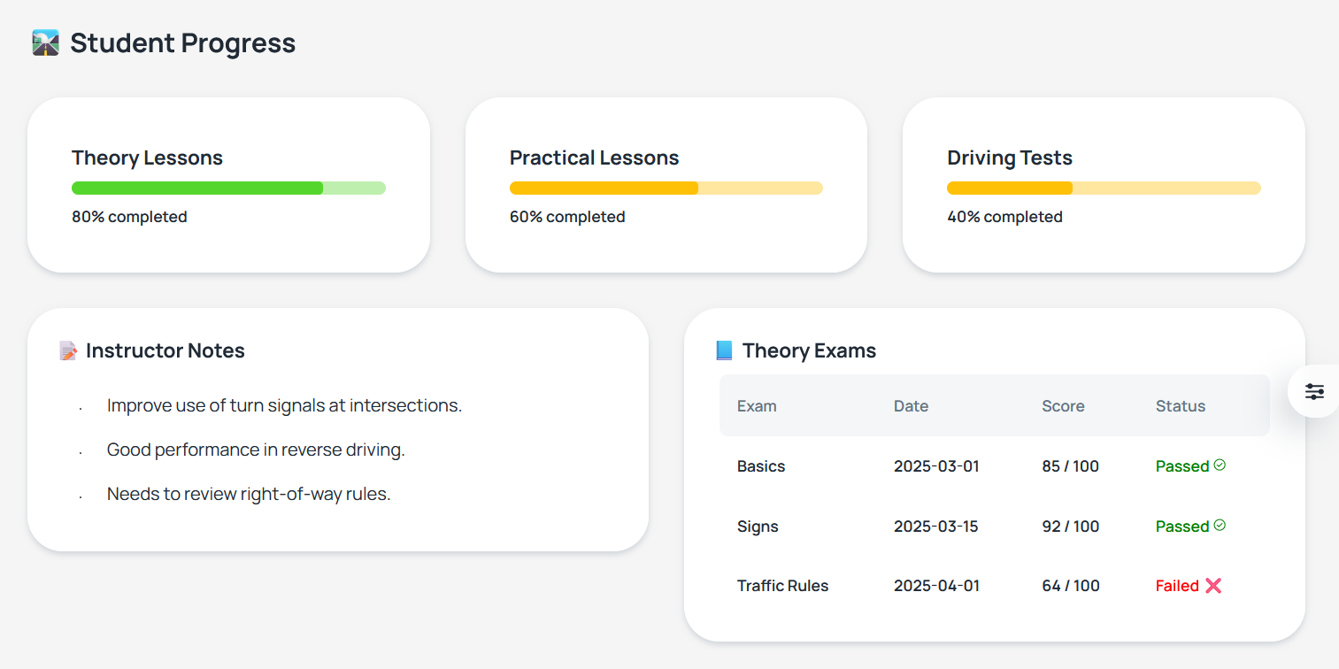
Now
Future
Practice for Theory Exams
Student Readiness Progress
Payment feature
Mobile app version
Online driving license session
Driving lessons booking

Slide 11
Explore Further:
GitHub repo:
Road Ready Link

Slide 12
Thank you
We’d like to sincerely thank our project supervisor, Dr. Mohamed Taya, for their continuous support, guidance, and encouragement throughout this project. Your patience and dedication meant a lot to all three of us, and we’re truly grateful for everything you’ve done to help us succeed.

Slide 13
Questions?

